Slide 1


















Lighthouse Projects Glasgow, Scotland
www.stepupsmartcities.eu

Slide 2
www.stepupsmartcities.eu
Lighthouse & Step Up Projects
LIGHTHOUSE PROJECTS
Clyde Waterfront: NHS Southern General Campus & Fastlink
Commonwealth Games Athletes Village
Technology Strategy Board Future Cities Demonstrator
STEP UP PROJECTS
Street Lighting Retrofit South Clyde Energy Centre Shieldhall
Ibroxholm DH Glasgow House
Wyndford State CHP City Centre North DH
PassivTEN: Glasgow Tenements Clyde Gateway East Smart Grid
Municipal Glasgow Strategic Drainage Plan
Page <number>

Slide 3


www.stepupsmartcities.eu
TSB Future Cities Demonstrator
Picture?
An ambitious programme aimed at using technology & data to make Glasgow a smarter, safer and more sustainable city.
Page <number>

Slide 4
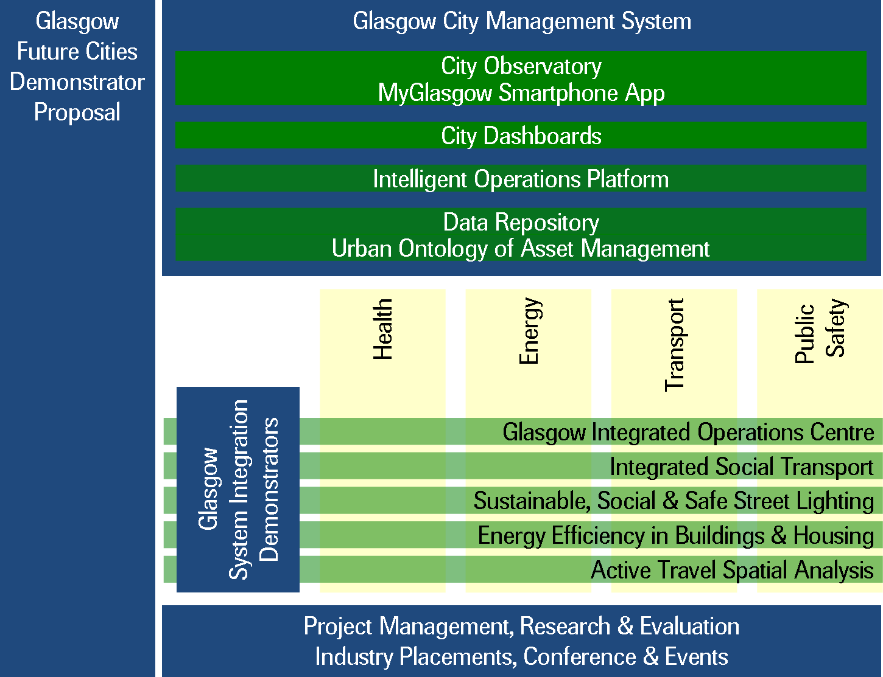
www.stepupsmartcities.eu
TSB Future Cities Demonstrator
Public, private and academic
sectors will combine expertise
and use cutting-edge
technology to enhance day-to
day life in the city. It integrates
issues such as public safety,
transport, health, technology
and sustainable energy.
Enabling Platform
Benefits Realisation
Page <number>

Slide 5
www.stepupsmartcities.eu
Actors
Glasgow City Council
Glasgow Community & Safety Services
Sustainable Glasgow
Health providers
Energy suppliers
Glasgow’s Universities
Wider SME/private sector
Citizens
Page <number>

Slide 6
www.stepupsmartcities.eu
Integrated approach
Integrated Operations Centre: managing a new futuristic public space CCTV network and TRAFFCOM roads management systems.
Sustainable Glasgow: efficient energy conservation/generation, use of green technology, air pollution and integration of active transport (walking and cycling) routes with public transport networks.
Big Data Store: collecting and analysing information from previously unconnected databases to influence future city services and developments and make it more accessible to more organisations.
Centralised City Dashboard: giving agencies and the public real time information on subjects like traffic flow, weather alerts, accident and emergency waiting times, rail and bus services and roads gritting. Access will be via smartphone apps and customisable interface.
Page <number>

Slide 7
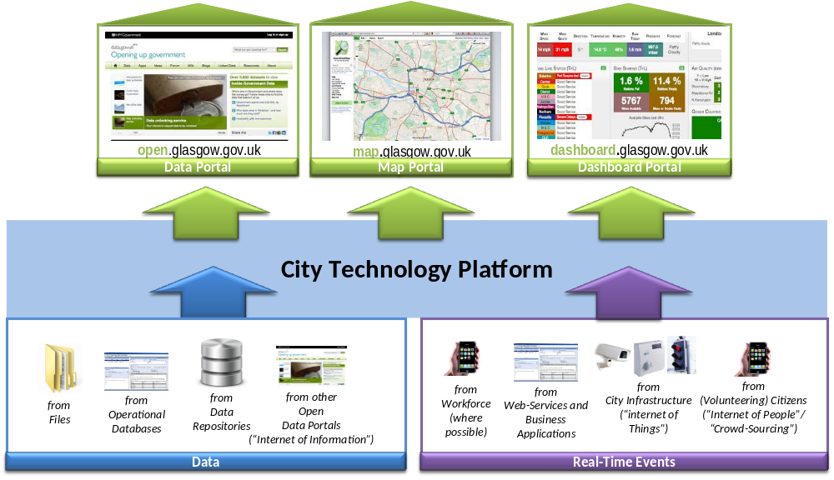
www.stepupsmartcities.eu
Data Platform & Web Portals
Page <number>

Slide 8

www.stepupsmartcities.eu
Integrated Operations Centre
Page <number>

Slide 9
www.stepupsmartcities.eu
Budget
Cost: £24million
Finance: The Government's innovation agency - Technology Strategy Board (TSB)
Further investment being sought
Page <number>

Slide 10
www.stepupsmartcities.eu
Expected Results
Produces results in 4 main areas: health; energy; transport and public safety
Increase inward investment: fast/transparent public sector operating
Reduction of energy demands in businesses and in transport
Improvement in environment: reduced impact of transport, better building management and fleet management
Smart management of energy supply/demand in City buildings & utilities network
Improve crime prevention, reduction antisocial behaviour
Better functioning, more liveable cities, healthier and more sustainable
Page <number>

Slide 11
www.stepupsmartcities.eu
Key elements of success
Unique integrated approach to transport, energy, technology underpinning management of a city
Transforms Glasgow into a Future City, using the Glasgow City Management System to deliver a better service and real benefits to the quality of life of citizens and across the city.
Working with partners: “Glasgow works best when it works together”.
Stakeholders: sustained vision and leadership from leading organisations within Glasgow.
Page <number>

Slide 12
www.stepupsmartcities.eu
Problems along the way
Limitation/challenge | Solution
Fragmentation of data across the systems within Glasgow. | Sufficient technical expertise to ensure data is reliable for Glasgow City Management System.
Short Timescale | Ensure there is enough technical expertise to deliver real benefits in the limited timescale.
Sharing of access to live or private data (Data Protection) | Put in place agreements for members to facilitate sharing data.
Public Procurement and timings | Early identification of work packages and Prior Identification Notices (PINs)
Page <number>

Slide 13
www.stepupsmartcities.eu
Other things that need to be mentioned
The TSB Future City Demonstrator in Glasgow is a national trailblazer providing added opportunities for dissemination as a Lighthouse project.
Page <number>

Slide 14
www.stepupsmartcities.eu
For further information
Michael Burns
Sustainable Glasgow
Glasgow City Council
Michael.burns@glasgow.gov.uk
Page <number>

